Slide 1
KendoUI MVVM
The way of the ViewModel and the Binding
Telerik School Academy
Learning & Development
http://academy.telerik.com

Slide 2
Table of Contents
The MVVM design pattern
Model, View, ViewModel
Kendo MVVM framework
KendoUI views
Observable objects
Binding Views and ViewModels
Views and ViewModels in external files
Initializing Views with ViewModels

Slide 3
MVVM Design Pattern

Slide 4

Model-View-ViewModel
The MVVM pattern is a descendant of the MVC design pattern
Allows implementation of multilayer architecture
Uses separation of concerns (SoC) for higher developer performance
Divides application logic in multiple dedicated layers (modules) for easier extension and bug-fixing
Each layers has its own and cohesive purpose

Slide 5
Model-View-ViewModel (2)
Model-View-ViewModel has three primary layers:
Model
Contains data models - JSON
View
Contains UI logic (HTML,CSS, UI JS)
Binds to the ViewModel
ViewModel
Contains business logic
Keeps models of data, Views get what they need
Plays the role of the middleman

Slide 6
MVVM Architecture
View
(HTML, CSS, UI JavaScript)
Binds to
ViewModel
(data communication,
business logic)
Uses
Model
(holds the data)

Slide 7
JavaScript Frameworks Implementing MVC
MVVM was designed mostly for use in WPF/Silverlight, but its usable in JavaScript as well
Kendo.UI
Kendo UI Mobile
Knockout.js
Knockback.js

Slide 8
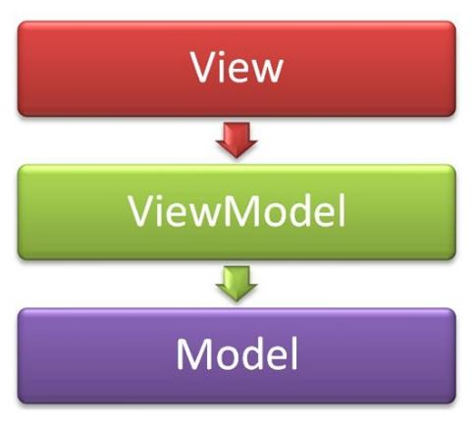
MVVM in KendoUI
Model – View – View Model

Slide 9
MVVM in KendoUI
Model
Represents data (database models, objects)
View Model
Fetches the data (from server, db, etc…)
And saves it into the Model
Exposes the data to the View
May have logic and functionality
View
Knows of the ViewModel
Represents UI (buttons, inputs, etc.)

Slide 10
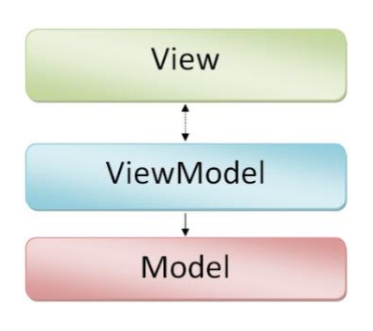
MVVM in KendoUI (2)
Model – kendo.data.DataSource
View Model – kendo.observable(JsonObject)
Object – has properties for the View
May have functions for manipulating data
View - kendo.View
string (template id)
string (template id) and ViewModel

Slide 11
MVVM in KendoUI: Example
Creating a View and a ViewModel
HTML:
<section id="view">
…
<a data-bind="html:title, attr:{href: url}"></a>
…
<p data-bind="html:content"></p>
</section>
JavaScript:
var viewModel = {
title: '…',
url: '…',
content: …' };
kendo.bind($('#view'), viewModel);

Slide 12
Creating Views
Live Demos

Slide 13
Data-binding in Kendo MVVM

Slide 14
Data-binding
Data-binding is the term for linking data to UI
Changes to any of them are applied to both
KendoUI has a powerful data-binding system
Bind HTML attributes, data-sources, etc
Done with the data-bind attribute
For a two-way data-binding the data must be an observable object
A regular JavaScript object, wrapper into kendo.observable

Slide 15
Data-binding: Example
HTML
<script type="text/kendo-tmpl" id="car-template">
<div>
<span data-bind="text: make"></span>
<input data-bind="value: power" />
<input type="checkbox" data-bind="checked: agreed" />
<div data-bind="visible: added">
</div>
</script>
JavaScript
var vm = kendo.observable({
make: '…', power: '…',
checked: true,
added: false
});
Kendo.bind(view, vm);

Slide 16
Data-binding
Live Demo

Slide 17
More of Data-binding
Data-binding can be done not just for attributes and properties
Methods can also be data-bound to events like click, load, change, hover, etc:
HTML
<button data-bind="events: {click: showInfo}">…</button>
JavaScript
var vm = kendo.observable({
…
showInfo: function(){
…
}
});

Slide 18
Data-binding Events
Live Demo

Slide 19
Views and ViewModels in External Files

Slide 20
Views and ViewModels in External Files
The ViewModel can easily be separated into multiple JavaScript files
The js code can be split into modules
Yet, having the HTML of all views into one page is hard for maintenance and extension
And the HTML code is harder to split into external files
The solution?
Creating a Views loader

Slide 21
ViewsLoader
Load a view by path and cache it
If it was already loaded, then return the cached
function loadView(path) {
if(cached[path]){
return cached[path]
}
HTTP GET path
success: save in cached
return result;
}

Slide 22
Views Loader
Live Demo

Slide 23
Kendo Views Layout

Slide 24
Kendo Views Layout
Dynamic changing of views is hard
Kendo MVVM has a kendo.Layout that fixes the problem
kendo.Layout is something like a master page, that has one or many placeholders
This placeholders can be filled with kendo.View

Slide 25
Kendo Views Layout: Example
Create the layout:
var layoutHTML = '<header>' +
'<h1>Title</h1>' +
'<nav id="main-nav"></nav>'+
'</header>' +
'<div id="page">' +
'</div>',
layout = kendo.Layout(layoutHTML);
Render it in div#root in the HTML page:
layout.render('#root');
Initialize the NAV view:
layout.showIn('#main-nav', navView);
Show the HOME view on the page
layout.showIn('#page', homeView);

Slide 26
Kendo Views Layout
Live Demo

Slide 27
KendoUI MVVM
http://academy.telerik.com

Slide 28
Homework
Create a SPA application for a social network
The application must have users
Users have username and password
Save the users in the browsers' localStorage
When a user is logs in, they can either view their images, or upload another images
Images have url and title
Save the images' data in localStorage
To be continued on the next slide

Slide 29
Homework (2)
*cont. Create a SPA application for a social network
The application must have atleast 3 views
Login/Register view
Shown if the user is not logged in
Images view
Show all the images of the user
Upload an image view
Implement the application using Kendo MVVM

